Slide 1
Final Review
Stat 133 spring 2018

Slide 2
Useful materials
Study guide
Lab
Homework
tutorials( if you still have time..)
Slides( if you still have time..)

Slide 3
Important concepts
Data type and Data structure
File structure
Bash shell / piplines
Package: dplyr (will provide cheat sheet)
Graphing : ggplot (will provide cheat sheet)
Markdown syntax
Regex (will provide cheat sheet)
Loops
Conditional structures :if – then – else
functions

Slide 4
Data type
Integer
Double
Logical
Character
Implicitly coercion: logical < integer < double < character
Explicitly coercion: as.character( ) as.integer( )
Data type and mode
Q : What is the results of TRUE +2
Q: What is the data type of matrix
2 4
‘q’ ‘m’
Q: which function checks the data type in R?

Slide 5
Data Structure :how to manipulate these objects
Atomic data structure: The values in vectors must be all of the same type(thinking of coercion here) ; Sub setting using [ ]
Vectors: recycling
Matrix: (Column- major: what does it mean?) (what do you expect to return: matrix[2])
Array
Non-atomic data structure: Sub setting using [ ] or $
List
Data frame (stored as lists) [ , ]

Slide 6
Sub setting
Numeric index : difference between max( ) and which.max( ), which( )
Logical Index player[positon == “C”, ]
Character index df[ , c(‘a’, ‘b’)]
See pdf attachment in midterm review

Slide 7
File Structure
Absolute paths
Relative path: Know how to navigate from current directory to target directory.

Slide 8
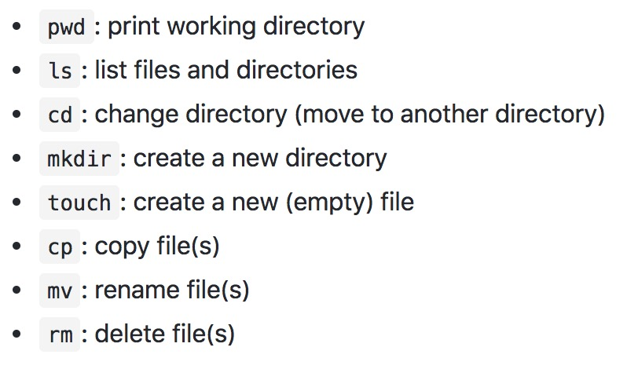
Bash Shell (release your mouse)
folder
sub1
sub2
sub3
Command option argument
If I am currently in sub3……
List files in long format ?
Make directory in folder, named sub4?
Rename files in sub2?

Slide 9
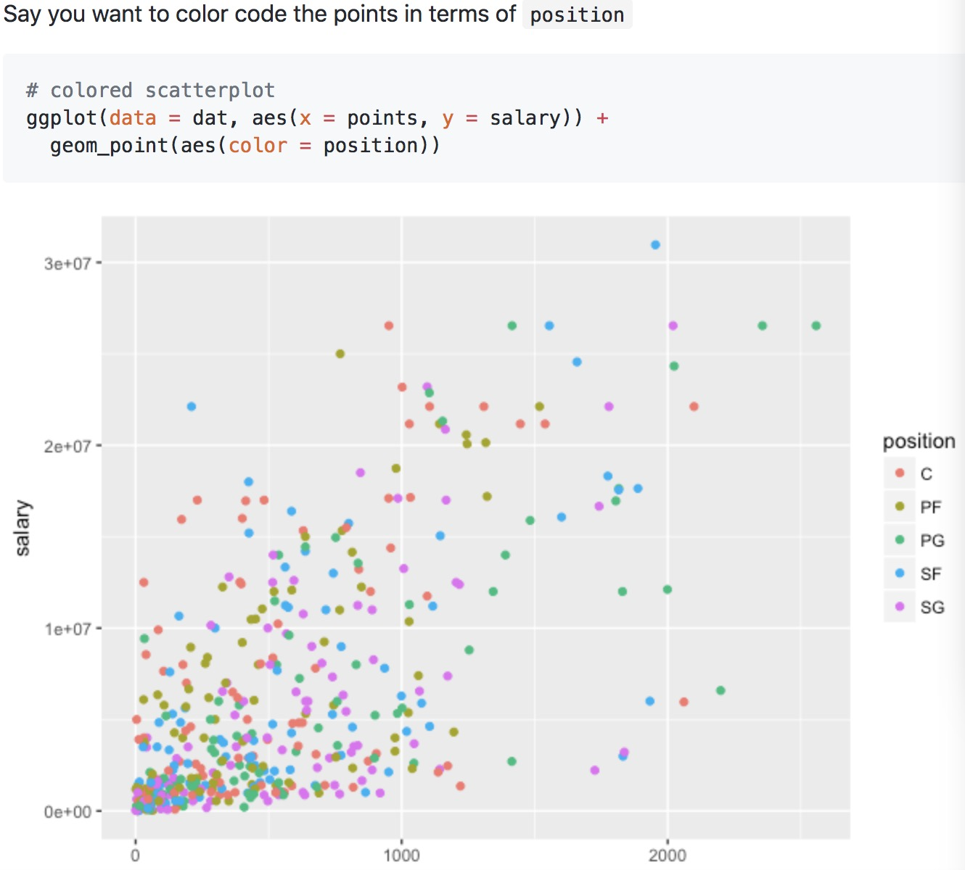
PLOT & ggplot
ggplot cheat sheet.
Always create ggplot objects by ggplot( ) first.
Important arguments: specify the type; faceting,
smoothing..

Slide 10
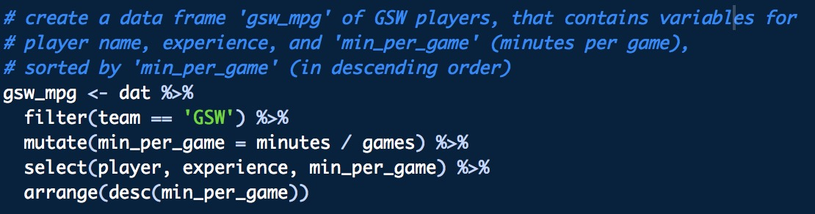
Dplyr
Pipe operator: %>%
Important functions:
filter : keep rows matching criteria
select: pick columns by names
mutate: add new variables
arrange: reorder rows
summarise: reduce variables to values
group_by: group observations by a column.

Slide 11
Markdown syntax
How to modify the font
How to include non-text thing into markdown

Slide 12
Conditionals: Different types of if-then-else --tutorial 10
if(condition) {
# do something
} else{
# do something else
}

Slide 13
Conditionals: Different types of if-then-else --tutorial 10
Minimalist if-then-else: when True part and False part are simple expressions, there’s no need to use braces
If(condition) expression_1 else expression_2
Simple if’s: when there is no expression in the False part
If(condition) expression
Equivalent to –
If(condition) expression else NULL

Slide 14
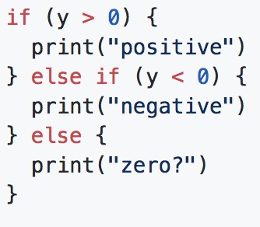
Conditionals: Different types of if-then-else --tutorial 10
Multiple if’s : when working with multiple conditions at the same time
Switch function: using many if-else statements with identical structures for slightly different cases (lab08)
ifelse function : ifelse(logical condition, yes, no)

Slide 15
LOOP: review lab 08, tutorials 12
For Loop:
for(index in 1:length(vector)){
body
}
for (element in vector){
body
}
Difference??

Slide 16
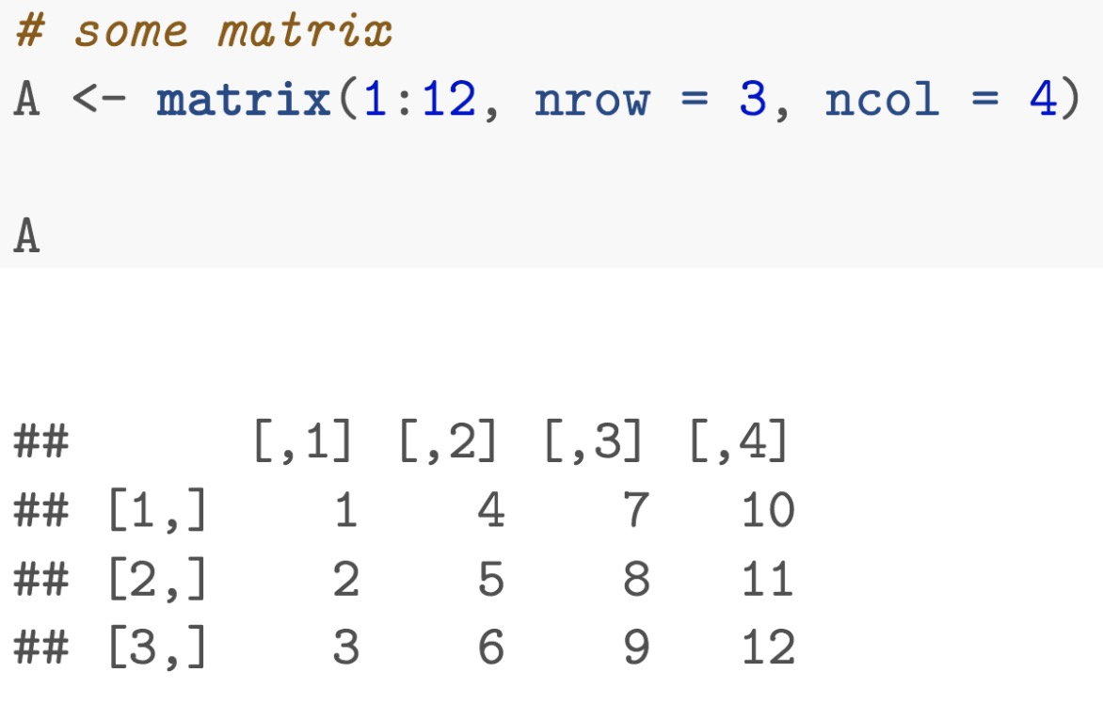
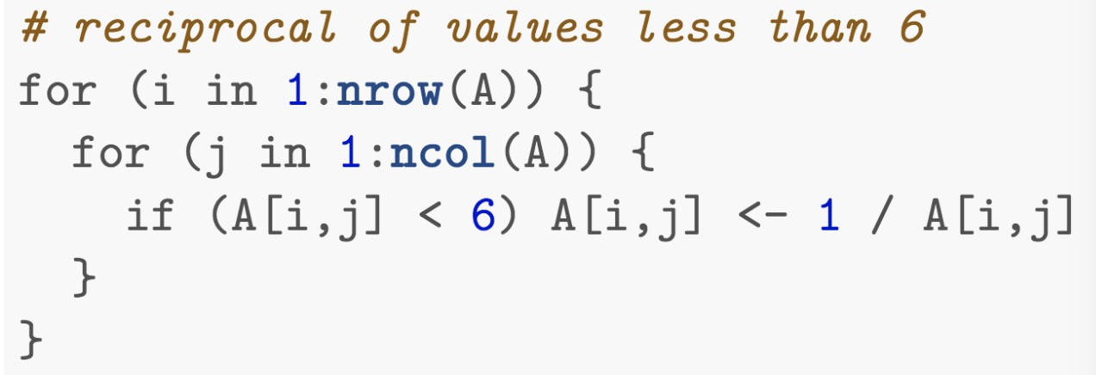
Example:
Given a matrix A with dimension 3*4 : nested loops

Slide 17
LOOP: review lab 08, tutorials 12
repeat loop:
repeat {
Keep_doing_something
if (stop_condition) break
}

Slide 18
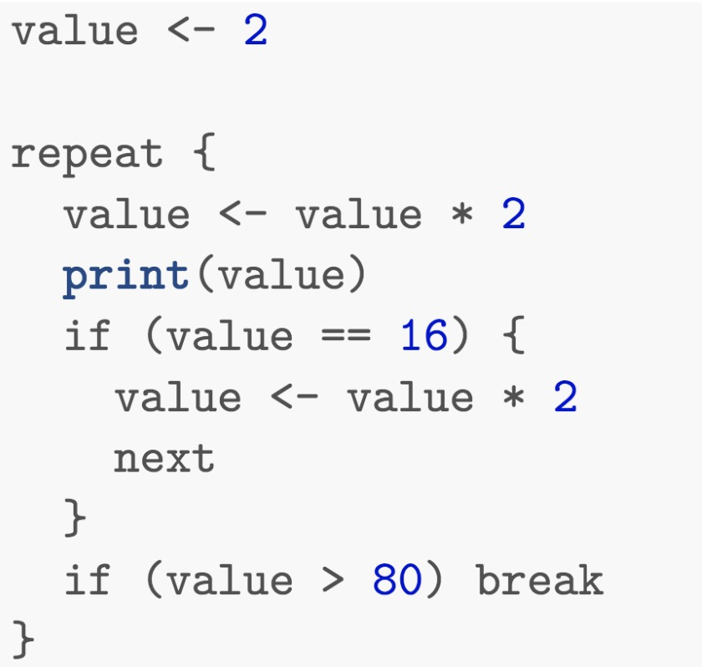
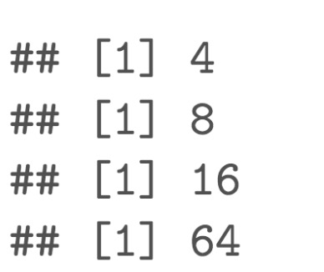
LOOP: review lab 08, tutorials 12
repeat loop: to skip a current iteration, use next

Slide 19
LOOP:
while loop:
while(condition){
keep_doing_something
}
Notes:
While loops are backward repeat loops
While checks first then attempts to execute
Computations are carried out for as long as the condition is true
The loops stop when condition is FALSE
If you enter an infinite loop, break it by pressing ESC

Slide 20
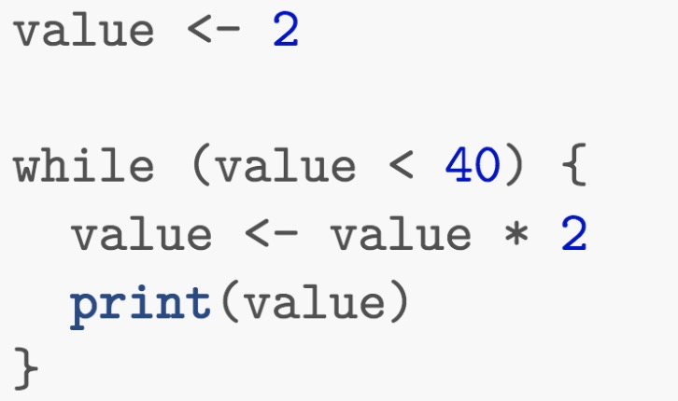
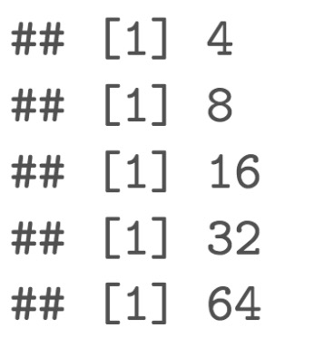
LOOP:
while loop:
Notes:
While loops are backward repeat loops
While checks first then attempts to execute
Computations are carried out for as long as the condition is true
The loops stop when condition is FALSE
If you enter an infinite loop, break it by pressing ESC

Slide 21
LOOP:
If you don’t know the number of times something will be done, use either repeat or while, If you know the number of times that something will be done, use for
While evaluates the condition at the beginning
Repeat executes operations until a stop condition is met

Slide 22
Function: Lab07 & tutorial 10
name <- function(arg1, arg2,……){
}
If no return statement inside the function, then return the last evaluated simple expression in the body of the function
Function names can’t contain ”-”
Function names cannot begin with a number, an underscore
Plus <- function(x ,y){
z <- x+y
}
Plus(2,3) doesn’t display anything in the console, why?

Slide 23
Regular expression –HW4 & tutorial15
Cheat sheet will be provided.
https://github.com/ucb-stat133/stat133-spring-2018/blob/master/cheatsheets/regular-expressions-cheatsheet.pdf
Escape metacharacters: \\
Match only one out of several characters: character class: [abcd]
. -- any characters except for line break
* -- match at least 0 times
+ -- match at least 1 time
Functions used with regex: Stringr package, grep, substr, substring

Slide 24
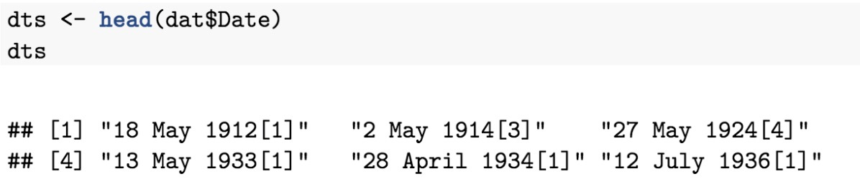
Example1
What to do if I want to remove these brackets after dates?

Slide 25
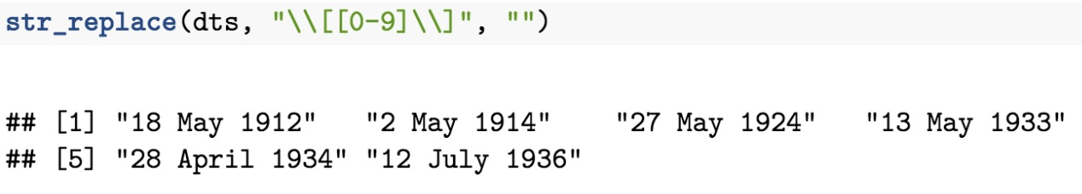
Example1

Slide 26
Example2
What to do if I want to extract phone numbers?

Slide 27
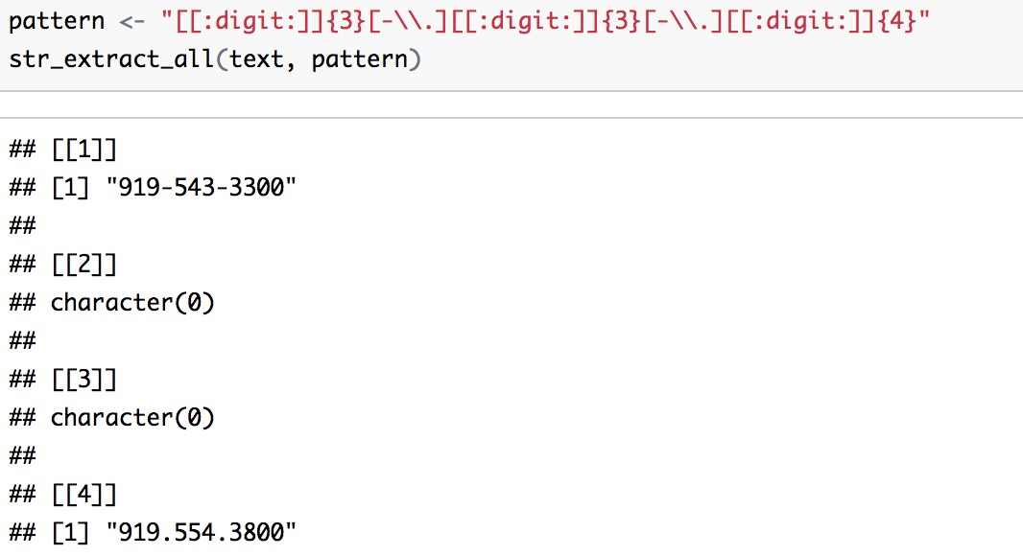
Example2

Slide 28
Command lines & Pipelines– Review hw3 Question2 & tutorial08
cut: select columns
grep : filter rows
sort : arrange lines/group by lines
uniq : count occurrences
wc: count word(-w), line(-l), character(-m), byte(-c)

Slide 29
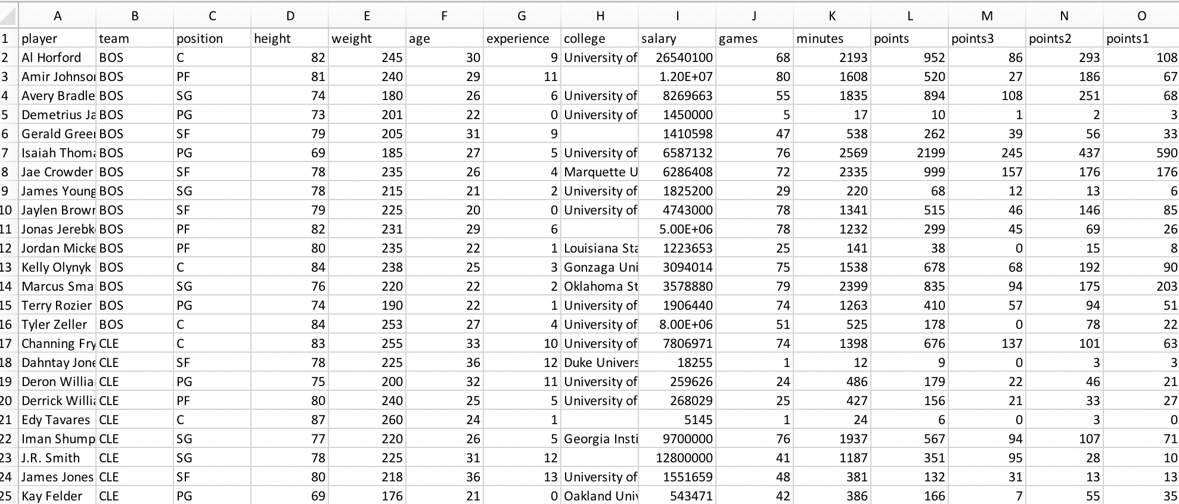
Command lines & Pipelines– Review hw3 question2 & tutorial 08
Write a pipeline to obtain the unique team names, and redirect the output to a text ﬁle team-names.txt. Use head to display the ﬁrst ﬁve lines of the created ﬁle

Slide 30
Command lines & Pipelines– Review hw3 Question 2 &tutorial 08
Write a pipeline to obtain the unique team names, and redirect the output to a text ﬁle team-names.txt. Use head to display the ﬁrst ﬁve lines of the created ﬁle
cut -f 2 -d “,” nba2017-roster.csv | tail +2 | sort -u > team-names.txt (difference between > and >> ?)
head -n 5 team-names.txt

Slide 31
Command lines & Pipelines– Review hw3 Question 2 &tutorial 08
Write a pipeline to obtain the counts (i.e. frequencies) of the diﬀerent experience values, displayed from largest to smallest (i.e. descending order). Redirect the output to a text ﬁle experience-counts.txt. Use head to display the ﬁrst ﬁve lines of the created ﬁle (output shown belown). The ﬁrst column corresponds to count, the second column corresponds to experience.
# frequencies of experience (descending order)
cut -f 7 -d "," nba2017-roster.csv | tail +2 | sort -n | uniq -c | sort -n -r > experience-counts.txt
head -n 10 experience-counts.txt

